Slide 1
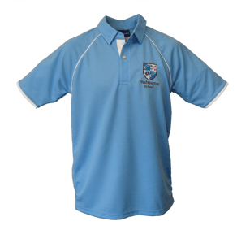
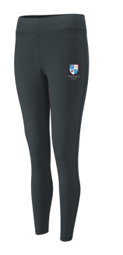
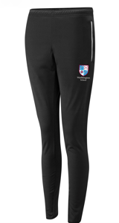
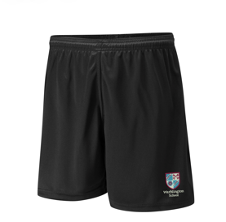
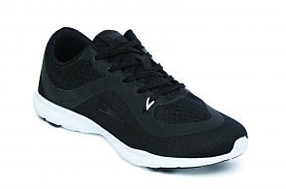
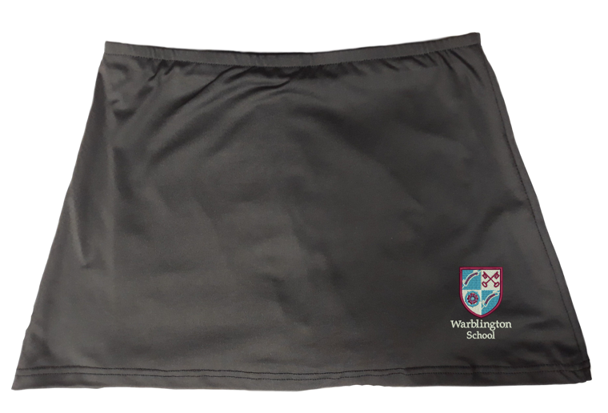
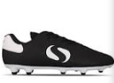
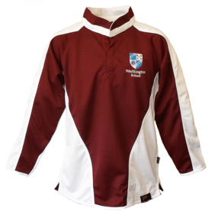
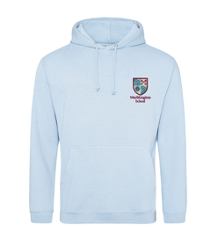
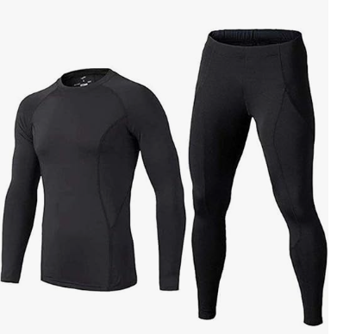
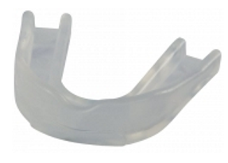
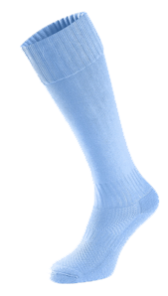
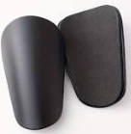
Physical Education Uniform
Trainers
Warblington PE Polo Leggings Tracksuit Bottoms Shorts Skort Football Boots
At least one of the following lower garments which are Warblington branded or plain black
No other brands are permitted
Compulsory Uniform
Expectations
Jewellery is to be removed or taped
Hair must be tied up
Support
The PE department offers support to
all students through the PE Swap
Shop. Students are encouraged to
trade items that they have outgrown
for pre-worn garments in a suitable
size.
Warblington Rugby Top Warblington Hoodie Mouthguard Blue Football Socks Base Layers
For Rugby and Hockey
For Colder Weather
Shin Pads
For Football and Hockey
Recommendations
Optional Uniform
For any queries please contact r.griffin@warblingtonschool.co.uk

